Slide 1
Fostering Curiosity and Understanding through Take-Apart Tinkering

Slide 2
Tinkering &Take-Apart in in the Elementary Classroom

Slide 3
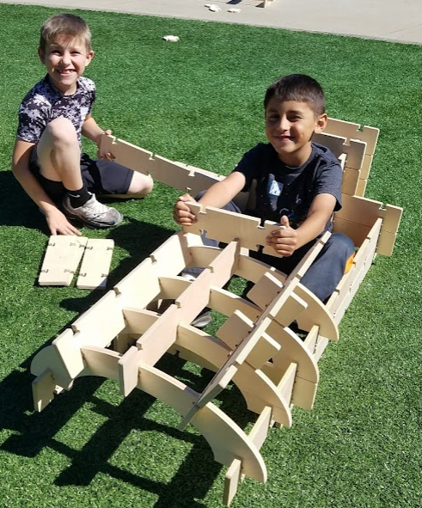
We learn about the world and advance through science, technology, engineering, and mathematics practices and experiences(Kelley & Knowles, 2016).

Slide 4
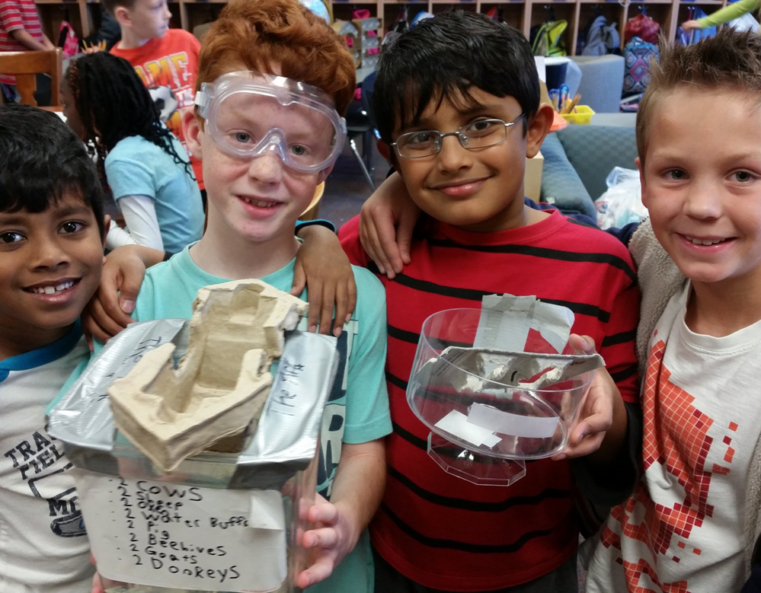
Tinkering
Playful
Experimental
Iterative
Engaging
Explorative
New possibilities
(Resnick & Rosenbaum, 2013)

Slide 5
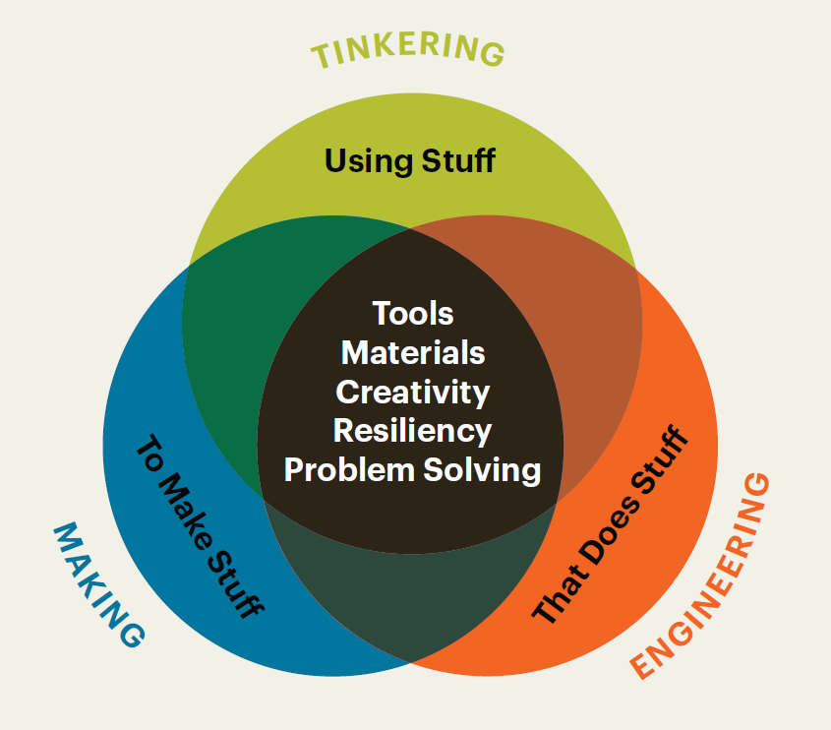
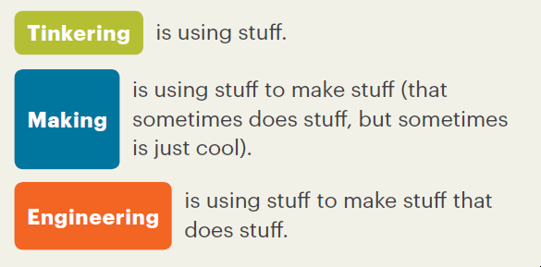
What You Need to Know About Tinkering, Making, and Engineering, NAEYC, Adapted from the Boston Children’s Museum, Tinker Kit: Educators’ Guide (Boston: Boston Children’s Museum, 2016), 4.

Slide 6
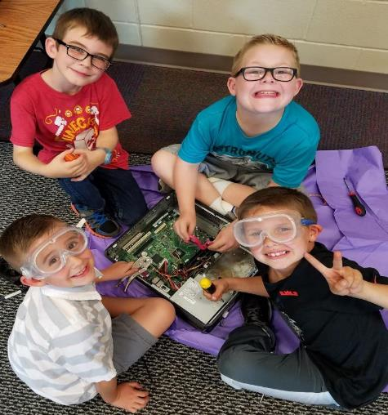
Slide 2

Slide 7
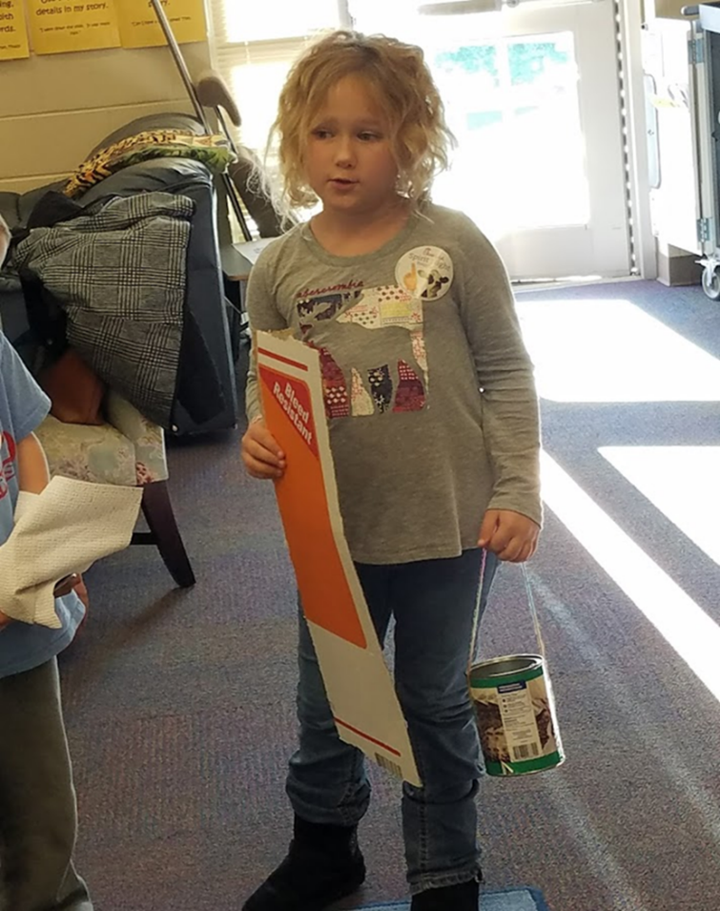
Tinkering
“Tinkering is undervalued (and even discouraged) in many educational settings today, but it is well aligned with…the goals of the progressive-constructionist tradition.”
(Resnick & Rosenbaum, 2013, p. 164)

Slide 8
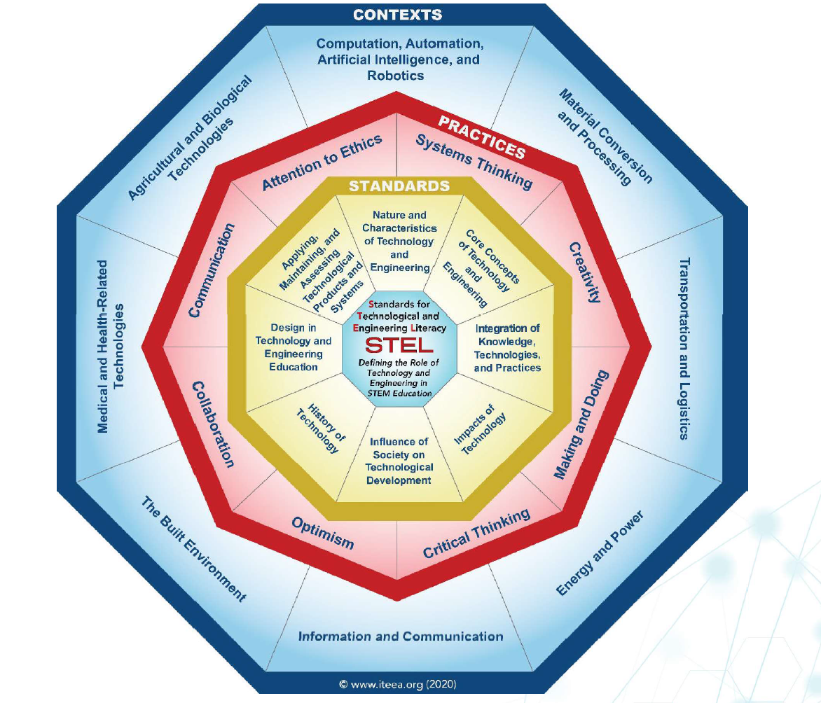
Structure of Standards for Technological and Engineering Literacy (ITEEA, 2020)
Practices
Systems Thinking
Creativity
Making and Doing
Critical Thinking
Optimism
Collaboration
Communication
Attention to Ethics

Slide 9
Things Come Apart: A Teardown Manual for Modern Living (McLellan, 2013)

Slide 10
Slide 6
transistor radio
mechanical pencil
combination lock

Slide 11
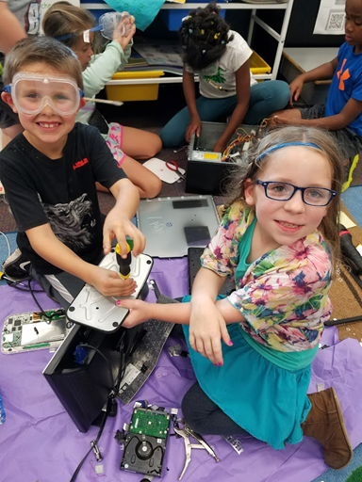
Take-apart
Process of Deconstruction
Real tools
Discover how things work
How are things made?
(Heroman, 2017)

Slide 12
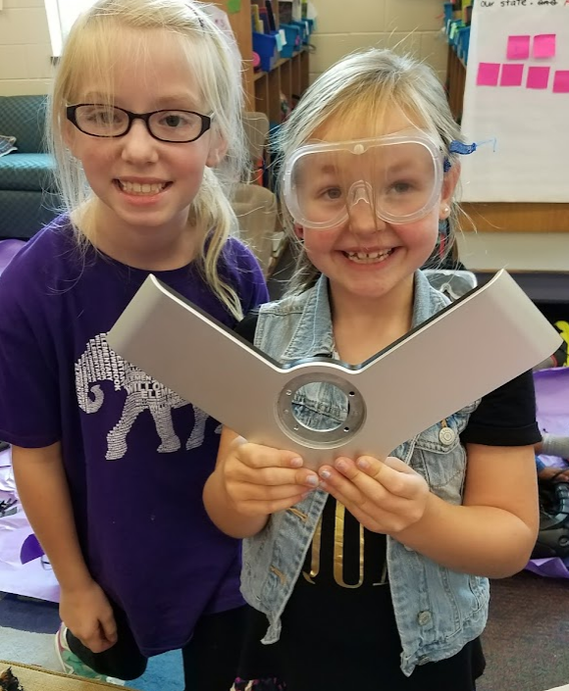
“The integration of engineering practices in the science classroom as early as grade one shows potential in fostering and sustaining student interest, participation, and self-concept in engineering and science” (Capobianco, Yu, & French, 2014).

Slide 13
Slide 2

Slide 14
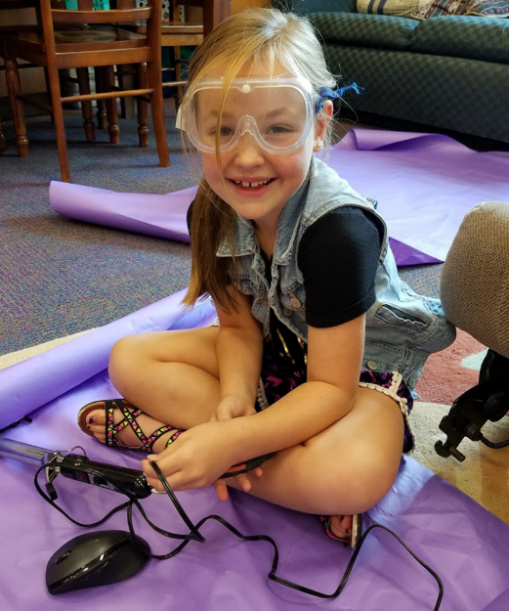
Tinkering and Take-apart Self-Efficacy
“Conviction that one can successfully execute the behavior required to produce outcomes…
Procedures, whatever their form, serve as means of creating and strengthening expectations of personal efficacy”
(Bandura, 1977, p. 193).
Preparing students to become technologically and engineering literate should not be left to chance (Move, 2019).

Slide 15
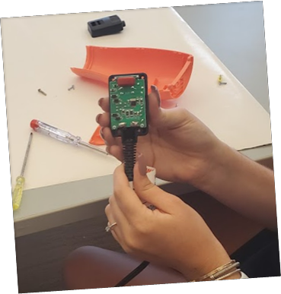
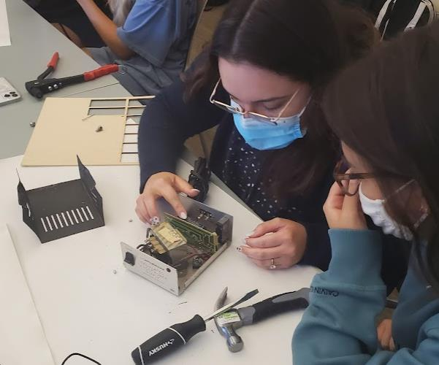
Slide 2

Slide 16
Tinkering and take-apart Preparing students to become technologically and engineering literate should not be left to chance (Move, 2019).

Slide 17
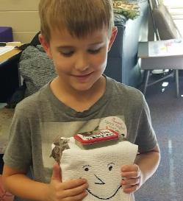
Page Title 7
”Elementary teachers are the gatekeepers to fostering the gifts and talents of future STEM innovators.”
(Cotabish, et. al, 2013)

Slide 18
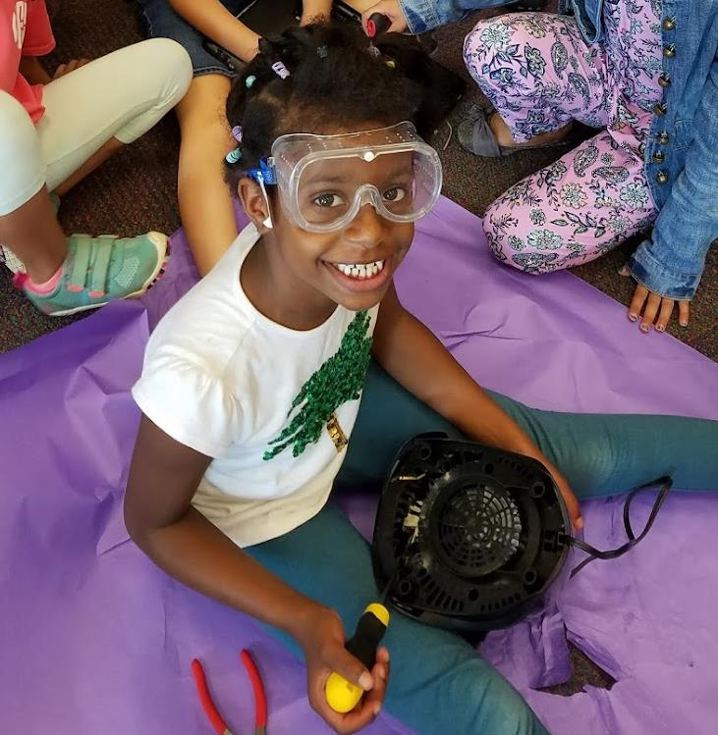
Comprehending how something works and applying that knowledge in a novel way depends on opportunities to tinker, take-apart, explore and create; things that define the foundation of learning engineering (Brophy, et. al, 2008).

Slide 19
Curiosity and Understanding through Take-Apart Tinkering
Your turn…

