Slide 1
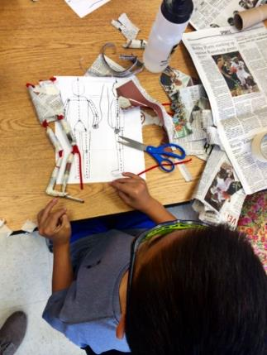
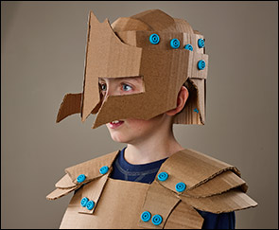
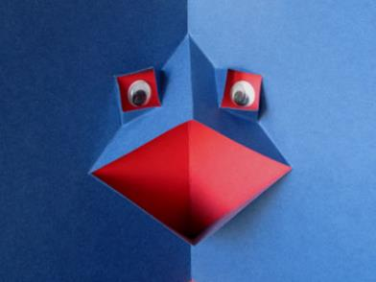
Introduction to Paper Engineering

Slide 2
Objectives: Learn to use project-based learning and engaging projects to develop basic pop-up cards and mechanisms from low or no-cost materials and supplies. Learn how to use simple materials and tools to develop paper engineering design challenges to address concepts in science, technology, engineering, mathematics, social studies, and English language arts.

Slide 3
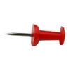
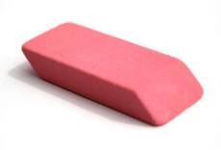
Low or No-Cost Tools & Materials
Tools:
Scissors, Hole Punches, Paper Drills, Rulers, Markers, Crayons, Colored Pencils,
Canary Cutters, Crop-A-Diles
Materials:
File Folders, Cardboard, Paper, Card Stock, Notecards, Construction Paper, Paper Fasteners/Brads, Glue, Craft Sticks, Fuzzy Sticks
Processes:
Measuring, Cutting, Gluing, Fastening, Folding, Sectioning

Slide 4
Linkages to STEM Skills and Concepts
Tools and materials
Sketches and models
The eng. design process
Communication of ideas
Investigate materials and
structures –
- aesthetics
- strength
- flexibility
Creativity and innovation
Brainstorming
Making transfer of knowledge
Exploring controls
Troubleshooting
Meeting wants and needs
Alternative solutions
Products and systems
Criteria and constraints

Slide 5
Linkages to 21st Century Skills
Collaboration: two or more people work together toward a common goal—typically an intellectual endeavor that is creative in nature —by sharing knowledge, learning and building consensus
Cooperation: the process of people or things working or acting together
Communication: a process that allows an exchange of information
Creativity: a mental process involving the generation of new ideas or concepts, or new associations between existing ideas or concepts.
Problem solving: higher-order cognitive process that requires the modulation and control of more routine or fundamental skills
*Partnership for 21st Century Skills

Slide 6
Curriculum Connections
Math
Manipulatives
Measurement
Angles
Ratio and proportion
Arc, diameter, circumference
Symmetry
Science:
Simple machines
Work
Force and motion
Models, illustrations
Materials/properties
Human-made structures
Energy (types, transfer)
Control systems
Human and animal body
structure
Social Studies
Structures
Inventions
People
Events

Slide 7
Curriculum Connections
Language Arts:
Illustrations for stories
Following directions
Communication of ideas
- verbal
- written
- pictorial
Vocabulary development
Journal writing
Oral presentations
Technology & Engineering
Mechanisms
Systems
Tools, materials,
& processes
Troubleshooting
Invention and innovation
Experimentation
Problem solving.
Physical Education/Health
How the body works
Anthropometrics/Scale

Slide 8
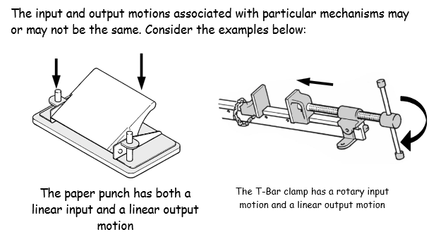
Mechanisms
All mechanisms transfer and control motion. The also have 2 things in common:
Input motion and force
Output motion and force

Slide 9
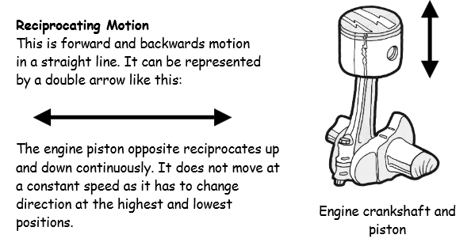
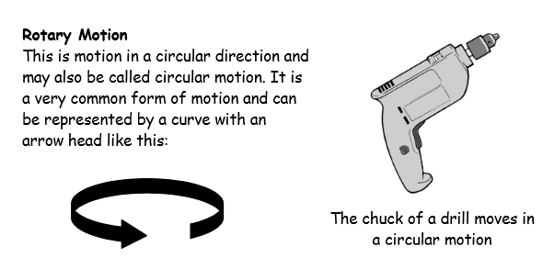
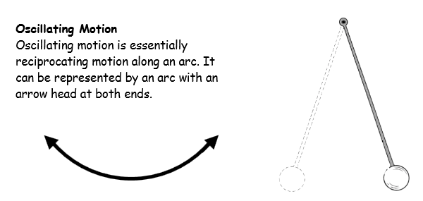
Mechanisms
Mechanisms use four types of motion

Slide 10
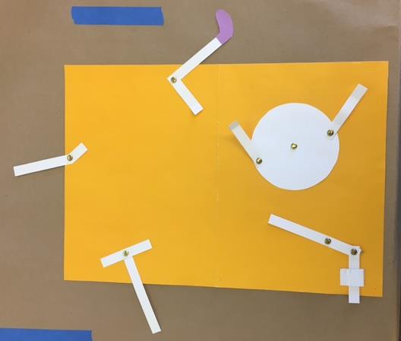
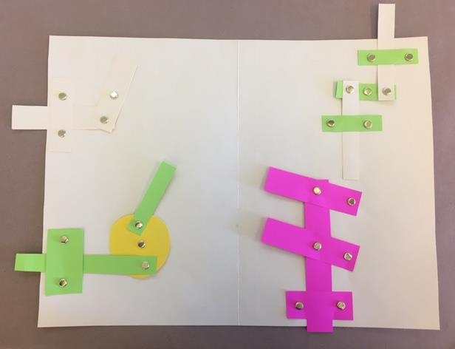

Slide 11
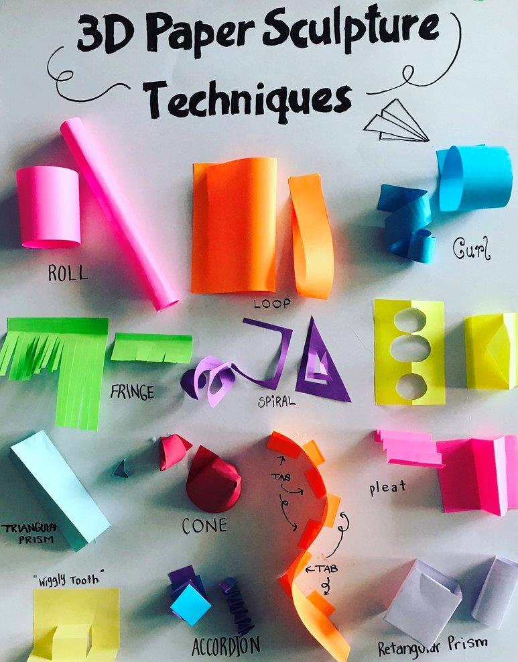

Slide 12
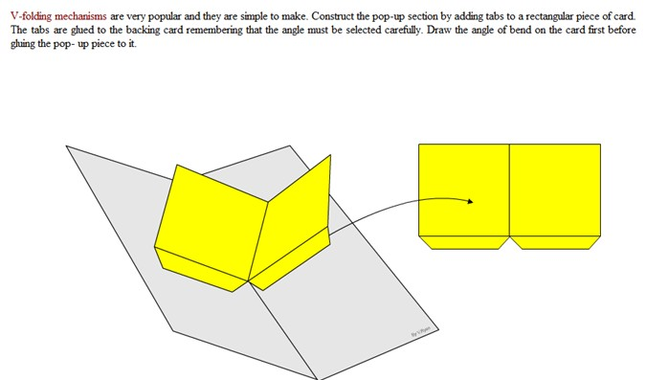
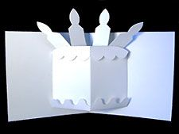
2-D
3-D

Slide 13
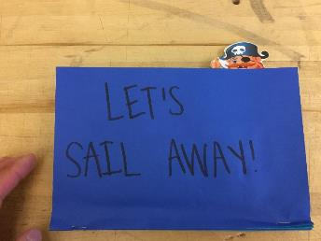
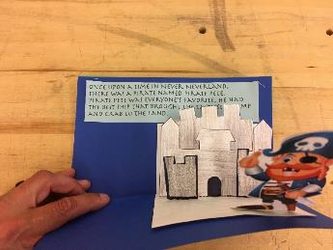
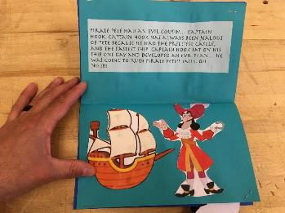
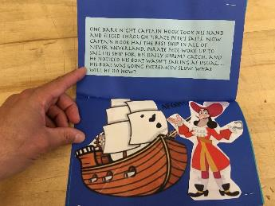
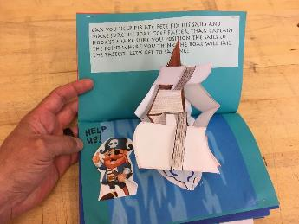
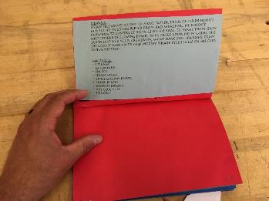
A few examples -

Slide 14
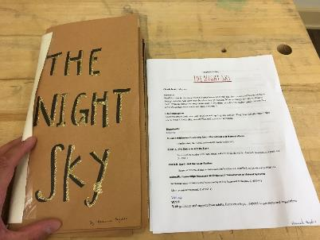
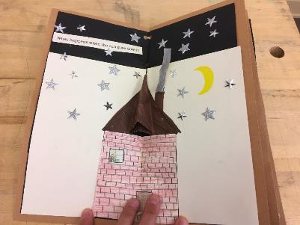
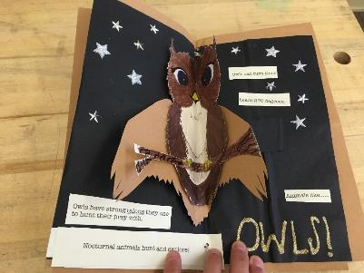
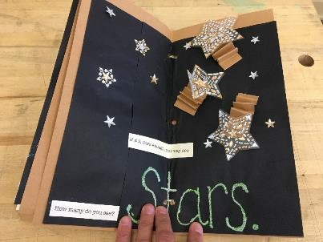
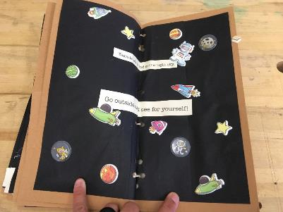

Slide 15
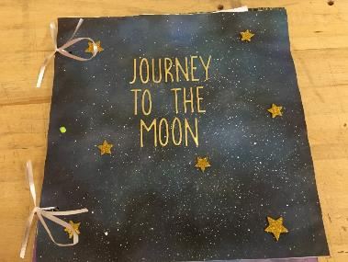
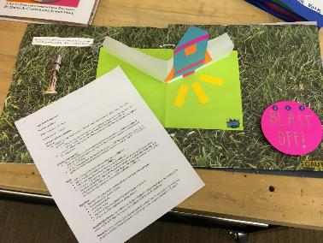
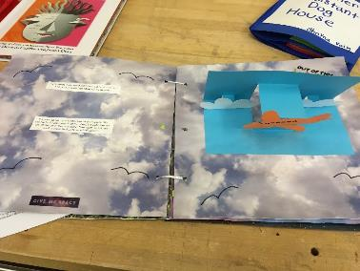
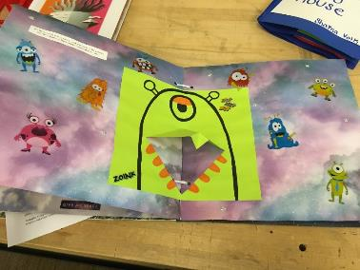
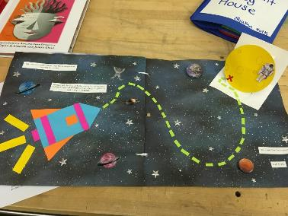

Slide 16
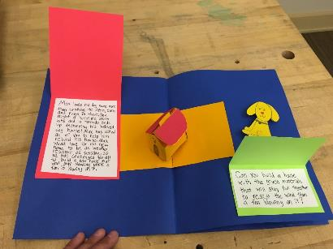
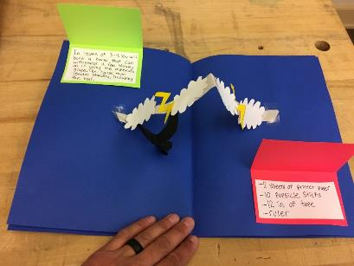
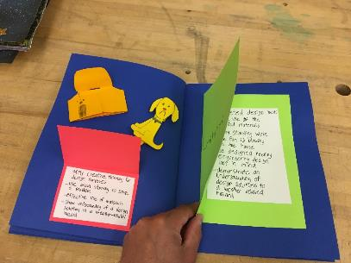
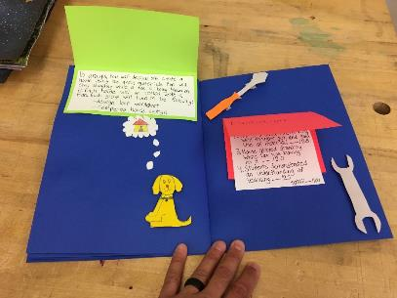

Slide 17
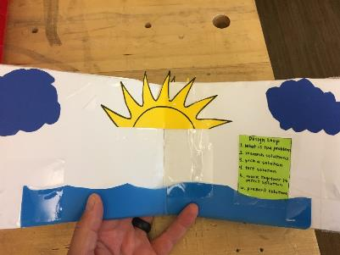
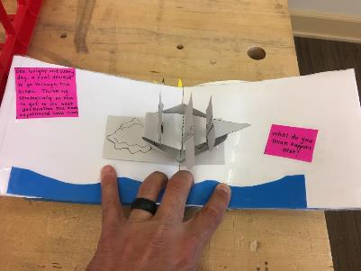
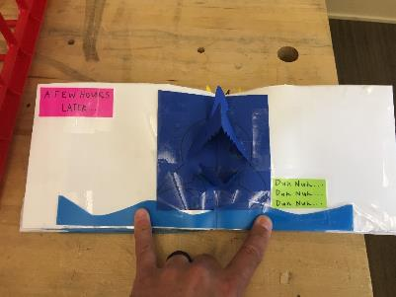
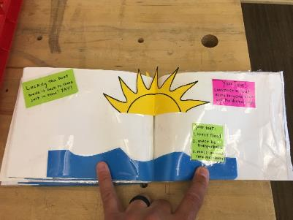

Slide 18
Resources
Pop-Up Templates
https://www.bestpopupbooks.com/pop-up-templates/
Pop-Up Video Tutorials - https://www.youtube.com/channel/UCx2M2bGHtXBszG6tuR_NIbQ

Slide 19
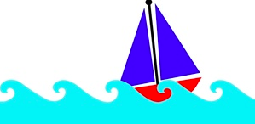
Ocean Layers
Background: We have just learned about the different characteristics of the ocean environment.
Challenge: Design a pop-up card that depicts your knowledge of the ocean environment such as: continental shelf, continental slope, continental rise, abyssal plain, and trenches.
Criteria: Your pop-up card should include:
Demonstrate at least three of the above terms
A minimum of two different pop-up mechanisms
A brief explanation describing the terms chosen
Should be neat and attractive
Include references
Materials: Unlimited
File Folders | Glue | Fuzzy Sticks
Construction paper | Craft sticks | Card stock
Tools: Unlimited
Scissors, Hole punch, ruler, Markers, Crayons, Colored Pencils

Slide 20
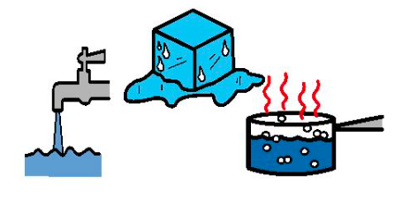
States of Matter
Background: We have just learned that the three states of matter are solid, liquid, and gas.
Challenge: Design a pop-up card that depicts your knowledge of all three states of matter.
Criteria: Your pop-up card should include:
Information for all three states of matter
A minimum of two different pop-up mechanisms
A brief explanation describing the states of matter
Should be neat and attractive
Include references
Materials: Unlimited
File Folders | Glue | Fuzzy Sticks
Construction paper | Craft sticks | Card stock
Tools: Unlimited
Scissors, Hole punch, ruler, Markers, Crayons, Colored Pencils

Slide 21
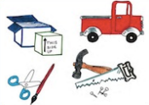
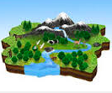
Resources
Background: We have just learned about natural resources, human resources, and capital resources.
Challenge: Design a pop-up card that depicts your knowledge of all three types of resources.
Criteria: Your pop-up card should include:
Information for all three types of resources
A minimum of two different pop-up mechanisms
A brief explanation describing the three resources
Should be neat and attractive
Include references
Materials: Unlimited
File Folders | Glue | Fuzzy Sticks
Construction paper | Craft sticks | Card stock
Tools: Unlimited
Scissors, Hole punch, ruler, Markers, Crayons, Colored Pencils

Slide 22
Other Paper Challenges: Paper Cantilever
Big Ideas:
Shear
Stress
Beams
Loads
Force

Slide 23
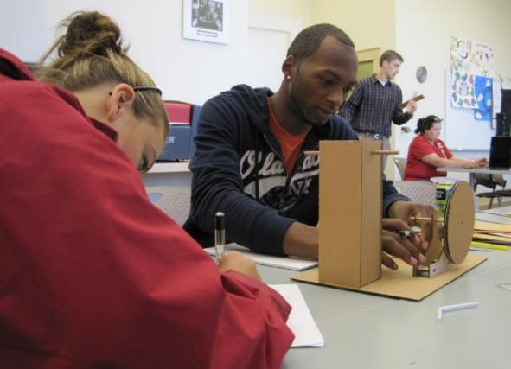
Other Paper Challenges: Basic Electricity
Big Ideas:
Circuits
Conductors
Insulators
LED’s
Conductivity

Slide 24
Other Paper Challenges: Paper Springs
Big Ideas:
Elasticity
Creativity
Weight
Potential and kinetic energy
Force

Slide 25
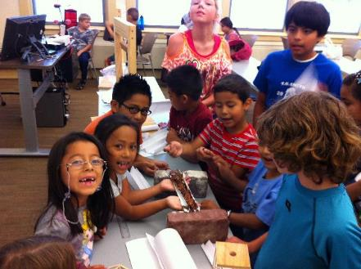
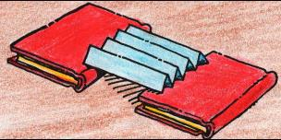
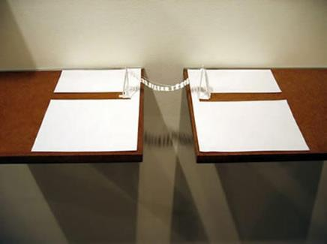
Other Paper Challenges: Paper Bridges
Big Ideas:
Materials
Angles
Strength
Loads
Force

Slide 26
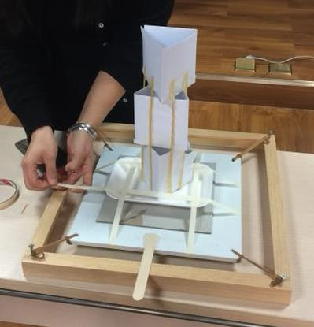
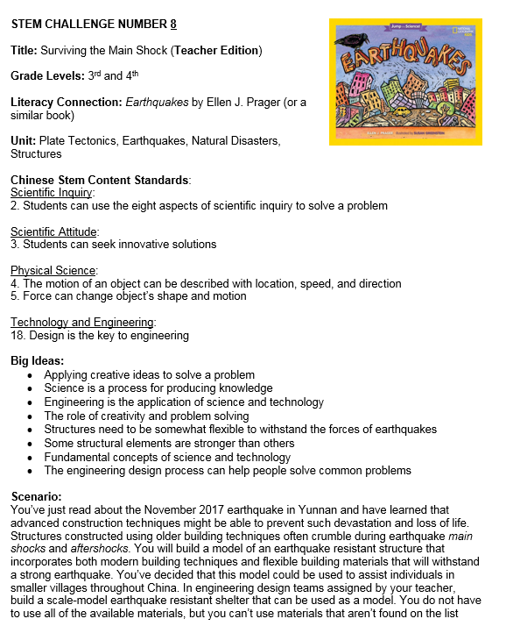
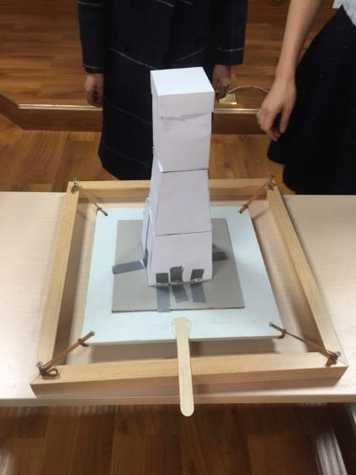
Other Paper Challenges:
Earthquake Proof Tower

Slide 27
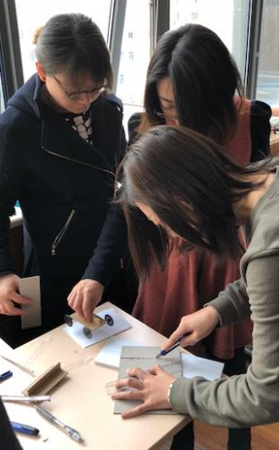
Other Paper Challenges:
Cardboard Racer

Slide 28
Other Paper Challenges:
Automata

Slide 30
https://know.make.do/

Slide 31
Scenario
Your community is trying to revive main street. Your class, known for creativity and innovation, has been asked to design multiple ‘living statue’ art pieces to be considered for the grand opening.
Challenge
Working with a partner and using the Makedo® tools, Canary cutters, and cardboard, design a ‘living statue’ of a famous person. One of the members of your team will need to be transformed into the ‘living statue’ when you present to the class.
Limitations
Must use a minimum of 15 Makedo Screws
Use only cardboard (although you may use markers for decoration)
Must be able to remain on your partner as you move to the performance site.
Time is limited, you will have 30 minutes to complete the design before we present to the mayor.

Slide 32
How can you design a Reach Extender that can retrieve a pencil from the floor in a seated position?
must add at least 12” to the student’s arm length and must be made only out of cardboard and Makedo® tools/fasteners.
use only scissors, Canary Cutters, and cardboard will be supplied.
Reach Extender

Slide 33
Yes, I’d Like a Mask Please
Scenario
In a weak moment, you agreed to accompany your weird cousin to a masquerade ball— your cousin in to all kinds of weird and embarrassing activities. Unfortunately, he often breaks into freestyle beatbox and rap battles at events like this. You want to support your cousin, but you do not want anyone to recognize you at this event. You need a fool-proof mask that will not fall from your face to keep your identity absolutely secret.
Challenge
Working with a partner and using the Makedo® tools, Canary cutters, and cardboard to create a fool-proof mask that will keep your identity secret during the masquerade ball. It would be mortifying if your identity were to be revealed. Time is limited, you will have 30 minutes to complete your mask.
Limitations
Must use a minimum of 5 Makedo Screws
Use only cardboard (although you may use markers for decoration)
Must be able to remain on your head (and your partners) without the assistance of your hands as you walk throughout the room.

