Slide 1
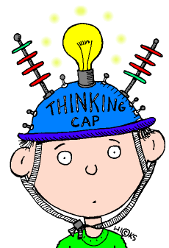
The Quick Challenge is …
Designed to engage the students’ attention usually at the beginning of class and draw them into the lesson.
Sometimes called the “anticipatory set,” the “hook activity,” or the “bell ringer”, it pulls student into the lesson.

Slide 2
Characteristics of the Quick Challenge
Similar to a hook activity
Differs from the anticipatory set or bell ringer in that it is activity-based
Short: 10-15 minutes maximum
Directly tied to the daily content/standards
Usually not graded
Usually, first exposure to the concept

Slide 3
Launched at the Beginning of Class
Directs student attention to the learning tasks at hand.
It exposes the students to concepts they are about to learn.
It is NOT about rote drill and kill.

Slide 4
Quickly Engages Students in the Topic
Expands upon student life experiences & background knowledge.
Puts students in a receptive mode.
Draws out major concepts to be learned
Introduces concepts to be learned
Engages students early
Provides purpose

Slide 5
Thus, the Quick Challenge Should …
create an organizing framework for the ideas, curiosities, principles, or information that is to follow.

Slide 6
If I were planning to teach a lesson related to STEL Standard #7 Design in Technology and Engineering Education and Benchmark A (Apply design concepts, principles, and processes through play and exploration), I might use the following quick challenge at the beginning of class to introduce the idea:
Students will work as a member of a small team and use a 6” square of aluminum foil to build a boat that will hold the most pennies. The vessel will be placed in a bucket of water and pennies will be added until the vessel sinks. Such an activity can be used to introduce the concepts of balance, stability, buoyancy, cargo, etc.
Such a quick challenge would be followed by an information session where Standard #7 will be expanded upon and other STEM content added. Then the lesson might conclude with a larger design challenge (i.e., carve a sailboat from Styrofoam that can be powered down a water-filled rain gutter with a box fan). This larger sailboat design lesson will:
Expand upon the knowledge and experience gained in the original quick challenge and add new features from related STEM standards (i.e., propulsion, time, distance, rate, graphing, etc.).

Slide 8
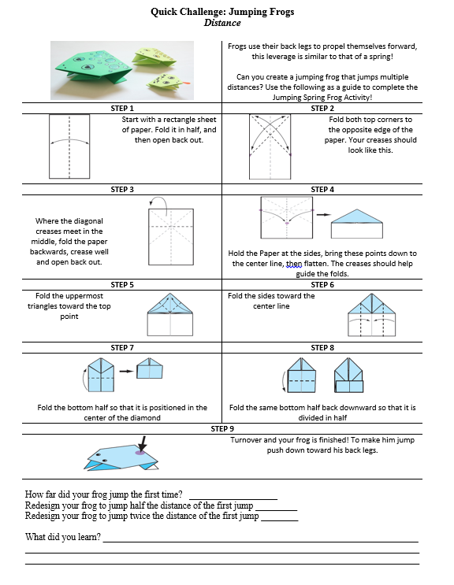
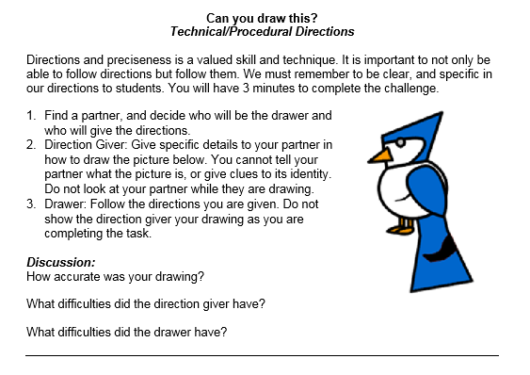

Slide 9
Character Cards can also be a great way to blend
Engineering Design Quick Challenges and Story Grammar
Story Grammar includes ……
The various integral components or elements of a story and the relationships among these parts. Typically, they include the character, setting, problem/conflict, plot, and resolution. Story grammar elements support the essential text structure for most narratives.
The grammar of the story is how the story is told and includes such things as plot, suspense, climax, and characters.
A framework including the basic elements of a story and the rules that explain the relationship between these elements.
A framework including the basic elements of a story and the rules that explain the relationship between these elements.

Slide 10
Character Cards

Slide 12
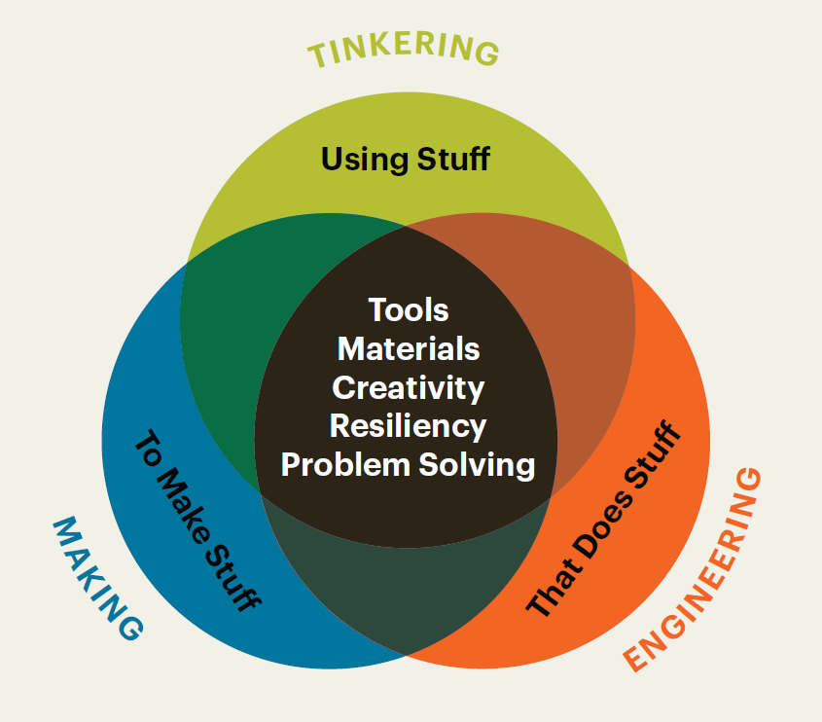
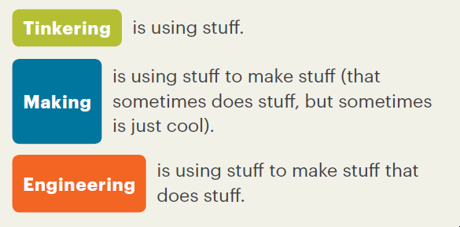
What You Need to Know About Tinkering, Making, and Engineering, NAEYC, Adapted from the Boston Children’s Museum, Tinker Kit: Educators’ Guide (2016)

Slide 13
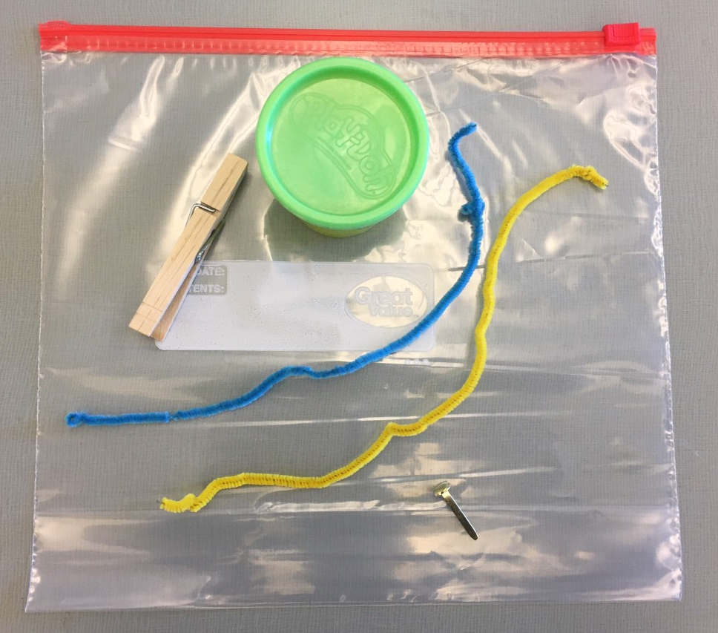
Making and Tinkering Bag/Toolbox

Slide 14
Character Card
Engineering Design Challenge
*developing empathy
How can you use the materials in your making and tinkering bag to improve your character’s life or to help them?
What could we create to help Curious George?

Slide 15
Character Card Quick Challenges
Home
Design a home, hideout, or space to relax for the character.
Recreation
Design an item or place that the character could play, exercise and have fun.
Accessories
Design an accessory that might enhance the look or comfort of your character.
Transportation
Design a mode of transportation that would work for your character.
Tools
Design a tool or gadget that would help your character solve a problem.
Free Choice
Design any of the above items.

