Slide 1


The Design Process
The Model #302 telephone was the standard for forty years.
How long will this one last?
Foundation Concepts for Teaching Problem Solving

Slide 2
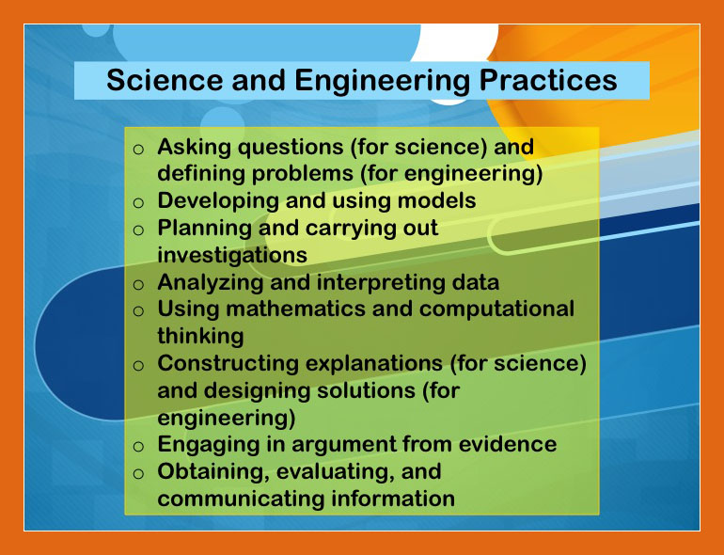



Slide 3
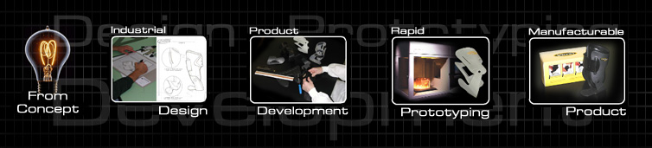
Engineering Design
“Design” is to Technology & Engineering as “Inquiry” is to Science and “Reading/Writing” are to Language Arts
Design is the core problem solving process
Design problem solving extends learning beyond the classroom

Slide 4
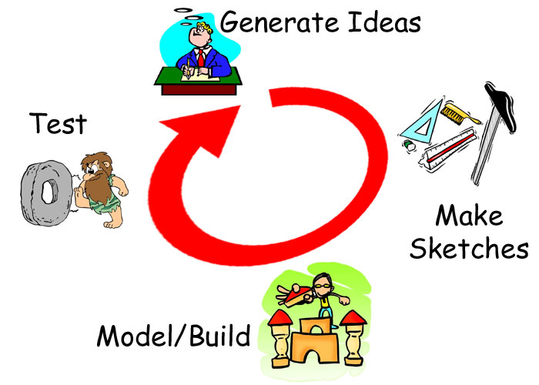
The Design Loop
Different tasks to be completed
  Suggested, rather than prescriptive
Identify the problem
Investigating
Developing ideas
Refining the idea
Modeling/prototyping
Evaluating/assessing
Communicating

Slide 5
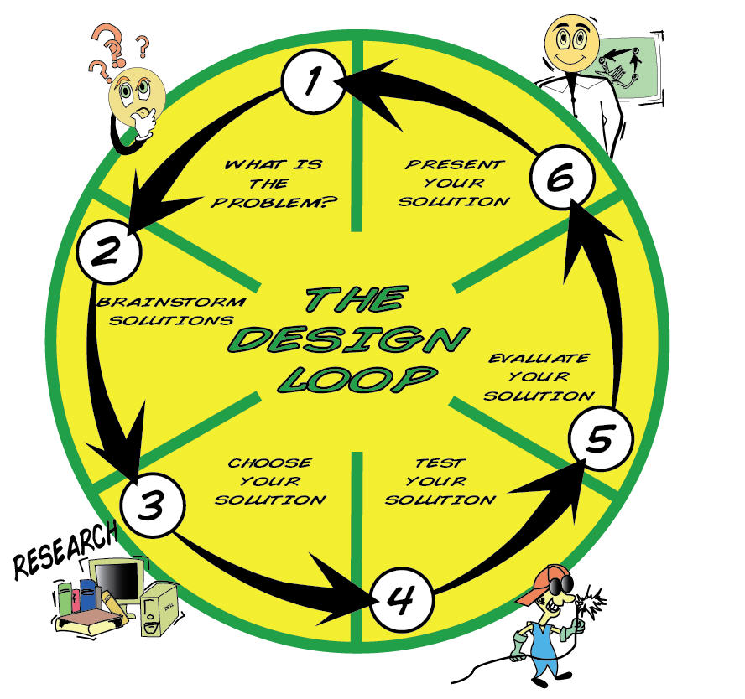
Missing the build, design, or creation stage/step

Slide 6
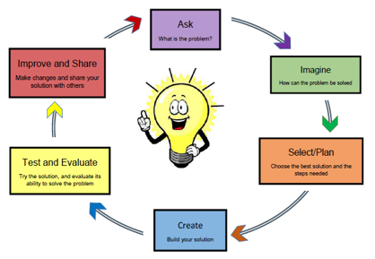

Slide 7
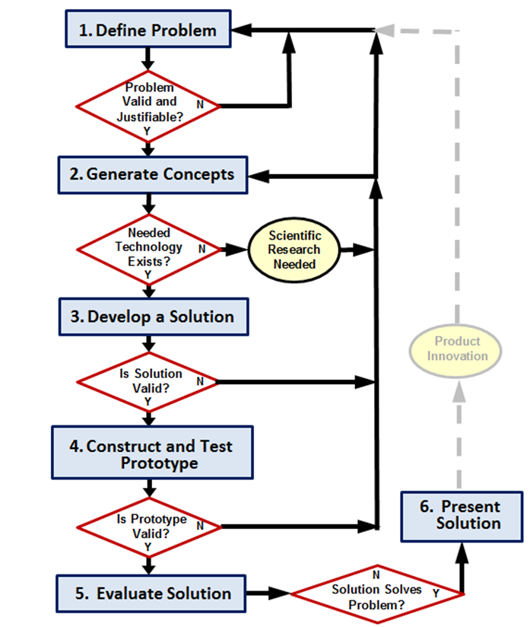

Slide 8


1. Understand the Problem
Before attempting to solve the problem, we must:
  Analyze the situation
  Determine “what is the actual problem?”
  Define the problem
  Understand the problem

Slide 9

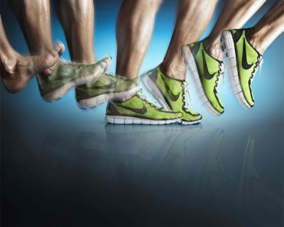
2. Investigate the Problem
Explore possible alternative solutions
  Conduct research
    Past experiences and knowledge
    Observations (examine similar problems/solutions)
    Discussions with people who
    have faced similar problems
    (interviews, telephone calls,
    e-mail)
    Search for new information
    (books, Internet, search of
    similar products)
    Explore community resources
    (shops, businesses, museums,
    industries)
Notes:
How have similar problems been solved in past?
What materials are available?
Time constraints
d. Technical constraints

Slide 10


3. Develop Ideas & Potential Solutions
Designers must ask questions
  Brainstorm
  Generate multiple ideas
  Consequences (intended and
  unintended)
  Identify alternatives
  Consider constraints
  Consider limits
  Consider specifications
  Consider risks/benefits
Notes:
Brainstorm potential solutions
Prepare multiple sketches
Limits may be personal, funds, time, skills, the market, human wants and needs, social constraints

Slide 11
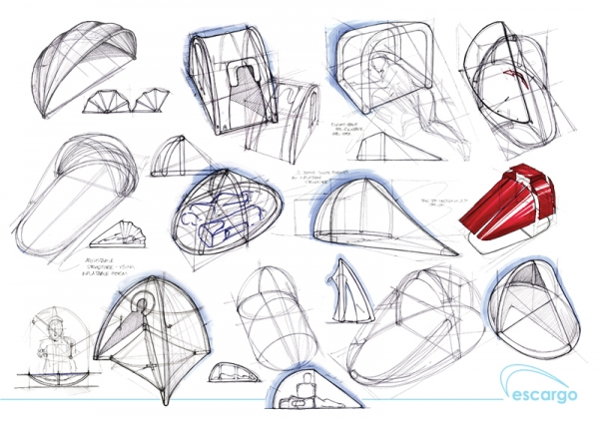
4. Refine & Detail Ideas
Sketches and drawings
Combining/separating
ideas
Assessing the potential
of various ideas
Generating specifications
Idea selection
Creating working and final drawings

Slide 12
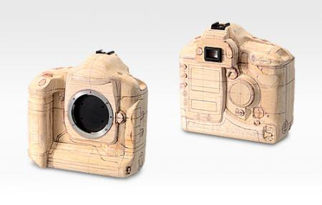
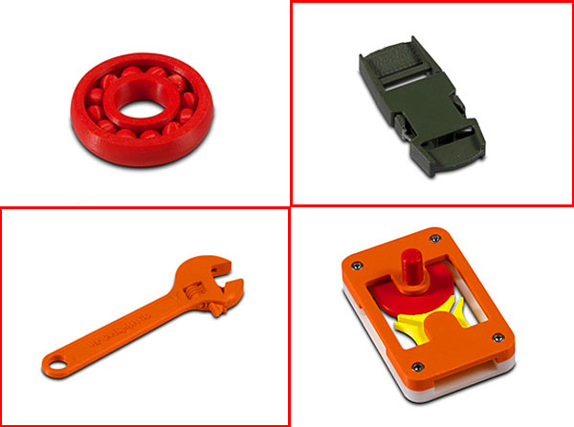
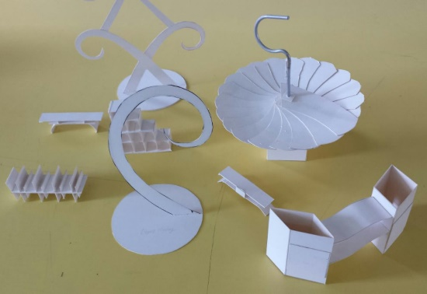
5. Mock-ups, Models & Prototypes
Planning (tools, energy, time, money)
Gathering materials and resources
Fabrication (models, prototypes)
Refinement
Testing

Slide 13
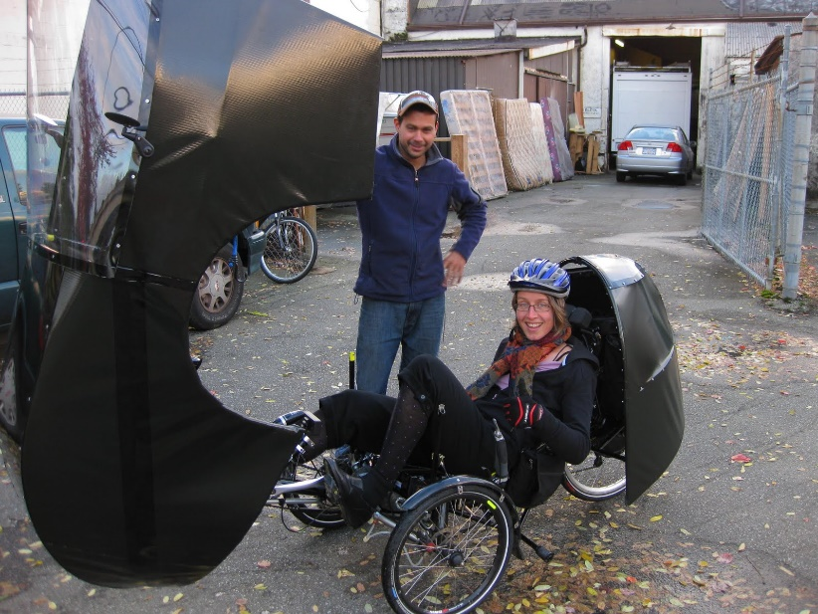
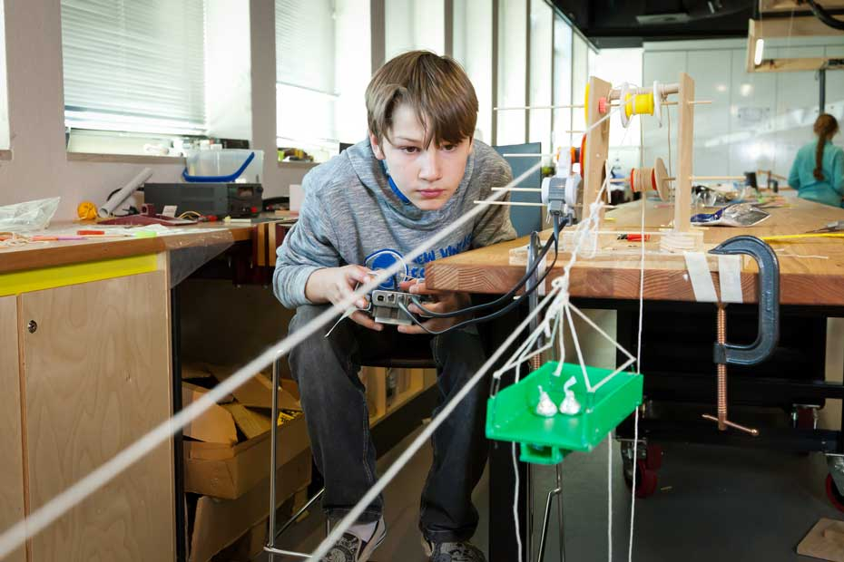
6. Evaluation & Assessment
Testing the solution
  Did the product/system solve the problem?
Evaluating the process
What could be changed in the future?
Is the proposed solution the simplest possible?

Slide 14
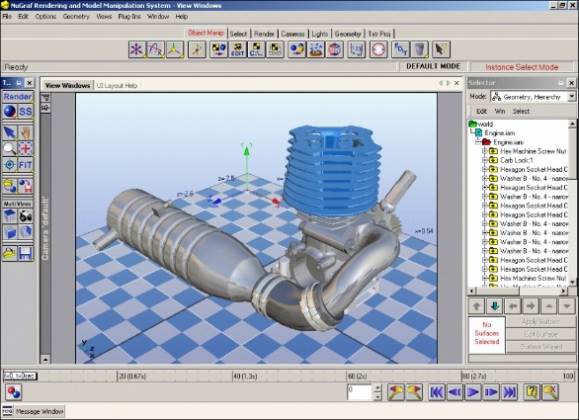
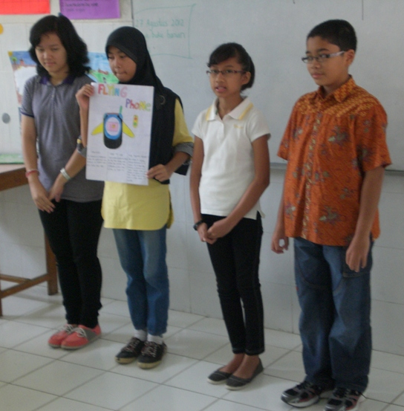
7. Communication
Recording and presenting the idea
  Drawings, sketches, graphs, materials lists
Documentation of:
  Major steps
  Materials/techniques used
  Discarded ideas
Demonstration of proposed
solution
Future changes/ideas

Slide 15
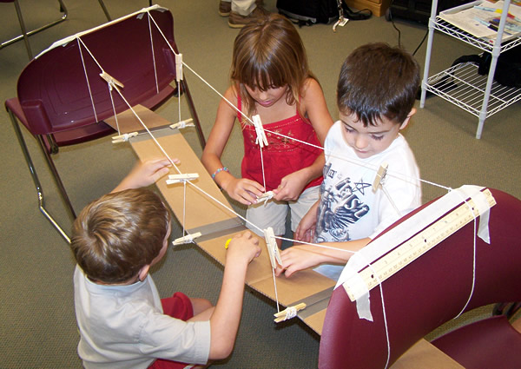
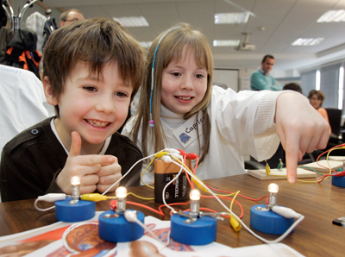
Why use Design Activities?
Reinforces course content/previous learning
Forces students to apply recently learned information (to solve a real problem)
Requires clear written/oral communication
Requires team work (collaboration)
Welcomes curiosity/rewards creativity
Requires transferability and application of knowledge – not just memorization

Slide 16
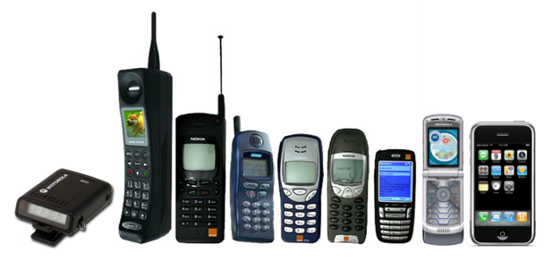
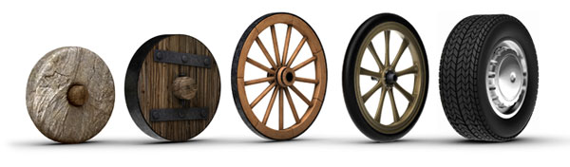
Characteristics of Successful Designs
Product Quality: Is it reliable? Does it meet the needs of the consumer?
Product Cost: Cost = Profit
Development Time: Time = Competitiveness
Development Cost: What was spent to develop the product?
Development Capability: Did the team learn something during the design process?

Slide 17
Role of the Instructor During Design Activities
Providing the foundation for learning
Determining content
Developing design problems for solving
Asking probing questions
Serving as a resource person
Facilitating collaboration among teams

Slide 18
The engineering design journal
Requires students to use the engineering design process
Compels students to document their creative process
Encourages brainstorming, collaboration, and innovation/invention
Fosters teaming capability - Did the team learn something during the design process?
Forces contribution from all team members.

Slide 19
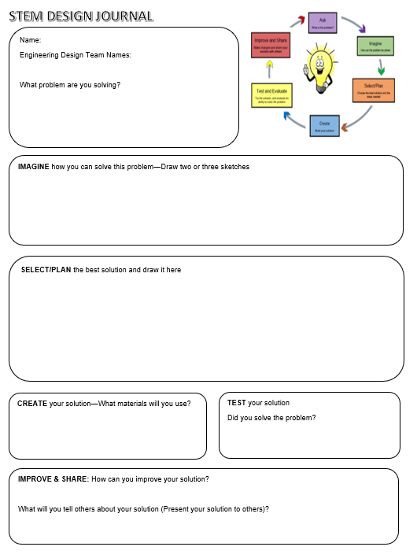

Slide 20
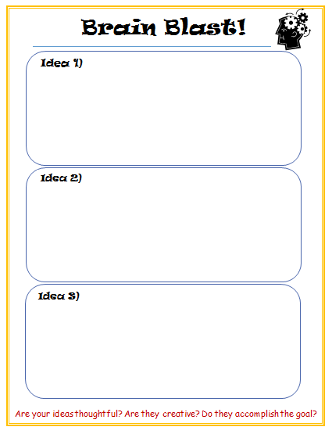
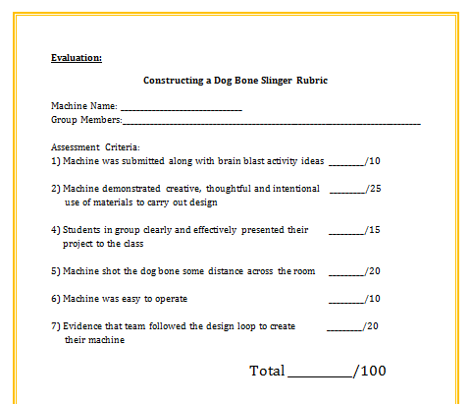


Slide 21
